Slide 1
Computer Security
Mark Carley
20071864

Slide 2

Top 3 Security Breaches Ranked in Order
1st – Ransomware attack in Baltimore, USA.
2nd – Ecuador data leak in Ecuador (Information Leakage)
3rd – WhatsApp malicious spyware attack (Effected EU)

Slide 3
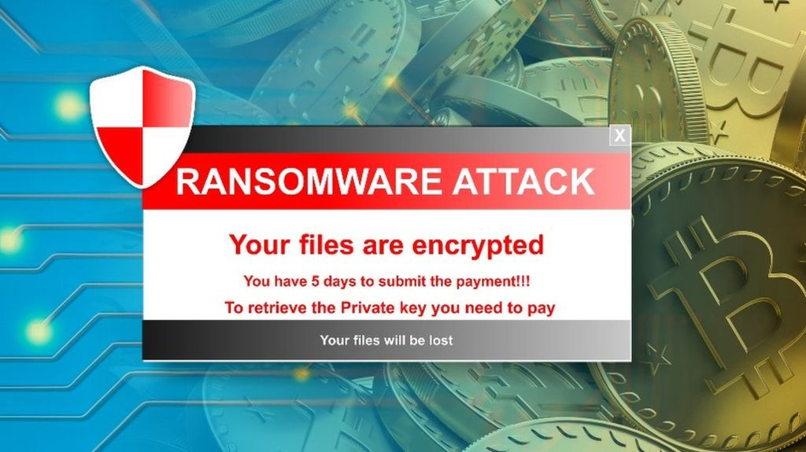
Baltimore Ransomware Attack
Occurred in May 2019 in the city of Baltimore, Maryland.
Infected by new strain of ransomware codenamed “robbinhood”.
Baltimore is second victim to this type of attack after Greenville, North Carolina (population over 500,000).
Most government servers on Baltimore city effected with exception to essential services.

Slide 4

Ransomware attack details
Ransomware is a type of malicious software, or malware, designed to stop computer access until a ransom is paid.
When servers were taken offline, a ransom note appeared demanding 13 bitcoin (roughly $76 thousand dollars at the time) in exchange for keys to unlock servers.
Only appeared to impact all government security systems in city, estimated fix for all systems would take weeks said officials.

Slide 5
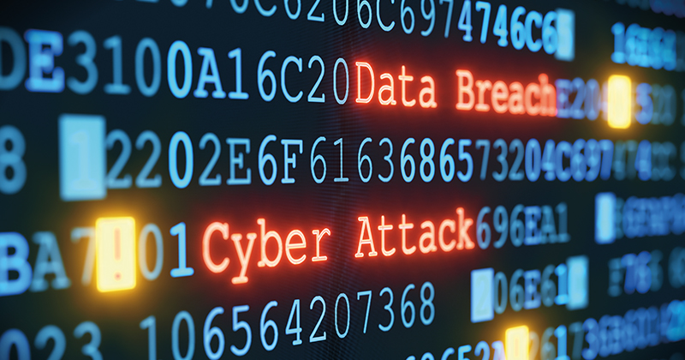
Aftermath of the ransomware attack
Baltimore advised not to pay ransom, cost the city over 18 million worth in damage.
Was very susceptible to this attack due to it’s IT practices, tight budget and a failure to allocate money to it’s internet security.
Might have been prevented if had backups of systems, devoted more income to there IT security department, deploy antivirus or employ content scanning and filtering for employee emails.

